Slide 1
Computer Networks

Slide 2
Computer Network
Data Link Layer
The physical layer provides only a raw bit-stream service.
Data link layer attempts to make the physical link reliable while providing the means to activate, maintain, and deactivate the link .
Sends and Receives packet to and from the network layer.

Slide 3
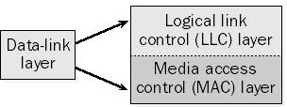
Computer Network
Data Link Layer
For LANs, the Project 802 standards of the Institute of Electrical and Electronics Engineers (IEEE) separate the data-link layer into two sub layers.

Slide 4
Computer Network
Data Link Layer
Logical link control(LLC) layer is the upper part of the two layers.
Responsible for flow control, error correction, and re sequencing functions for connection-oriented and connectionless communication which is been already discussed.
MAC layer is responsible to provide a method for stations to gain access to the medium.

Slide 5
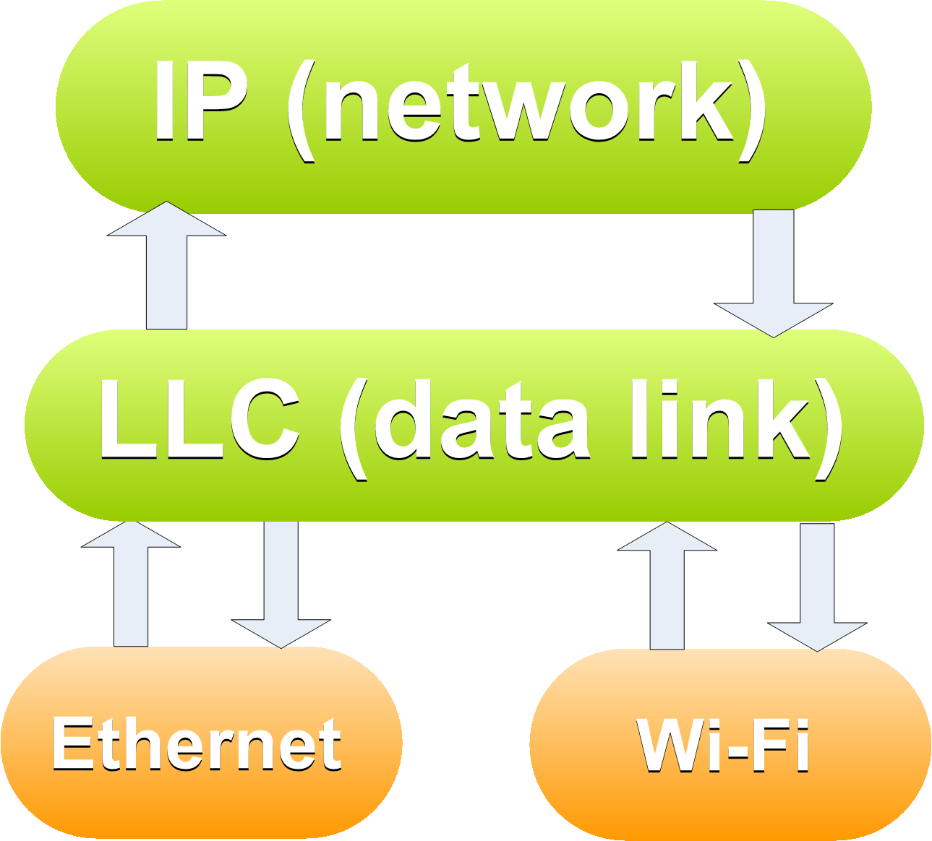
Computer Network
Media Access Control(MAC)
Send/ Receive packets to Network Layer.

Slide 6
Computer Network
Media Access Control(MAC)
Physical Layer provides binary send/receive to Data-Link Layer

Slide 7
Computer Network
Media Access Control(MAC)
But, different media have different constraints about multiple nodes accessing the medium.

Slide 8
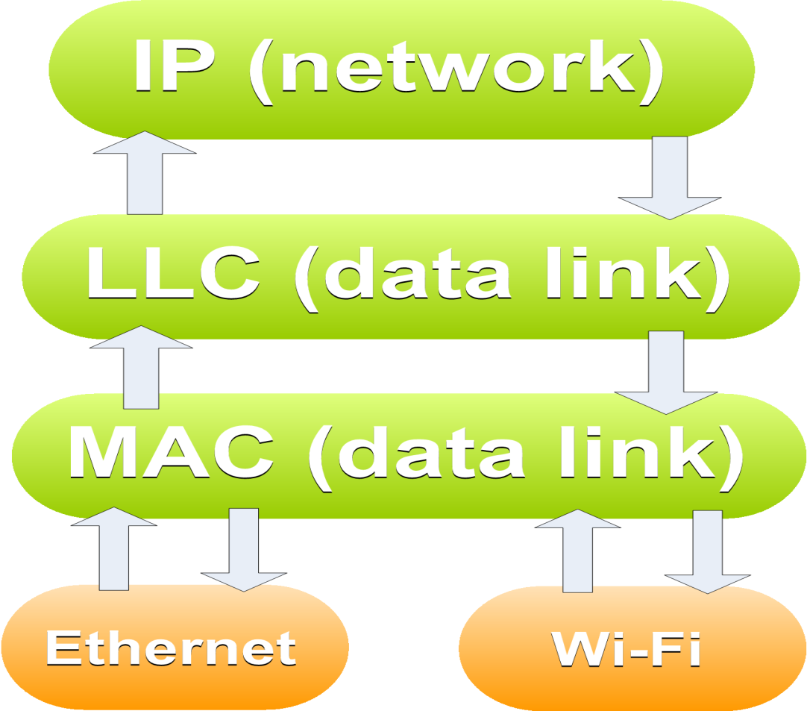
Computer Network
Media Access Control(MAC)
MAC layer provides medium-access service to the Data-Link layer
A separate protocol is needed to implement the service for each different transmission medium

Slide 9
Computer Network
Media Access Control(MAC)
Network links in broader expect is classified to
Point to Point Link.
Broadcast Link.
Broadcast Link or Channel are referred as multi access channel or random access channel.
.

Slide 10
Computer Network
Media Access Control(MAC)
MAC sub layer are more focused on Local Area Network(LAN) and wireless LAN.
Medium Access Control is a sub layer whose protocol determines use of multi-access channel.
Channel cannot carry two signals in the same frequency range at the same time.
.

Slide 11
Computer Network
Media Access Control(MAC)
To overcome this situation Single broadcast channel can be allocated among multiple user by
1. Statically.
2. Dynamically.
.

Slide 12
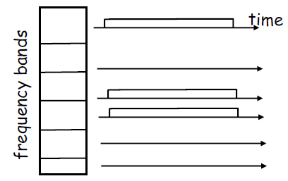
Computer Network
Static Channel Allocation
Traditional way of allocating channel is Frequency Division Multiplexing.
eg:- Telephony.

Slide 13
Computer Network
Static Channel Allocation
Channel spectrum divided into frequency bands.
Each station assigned fixed frequency band.
Unused transmission time in frequency
bands go idle.

Slide 14
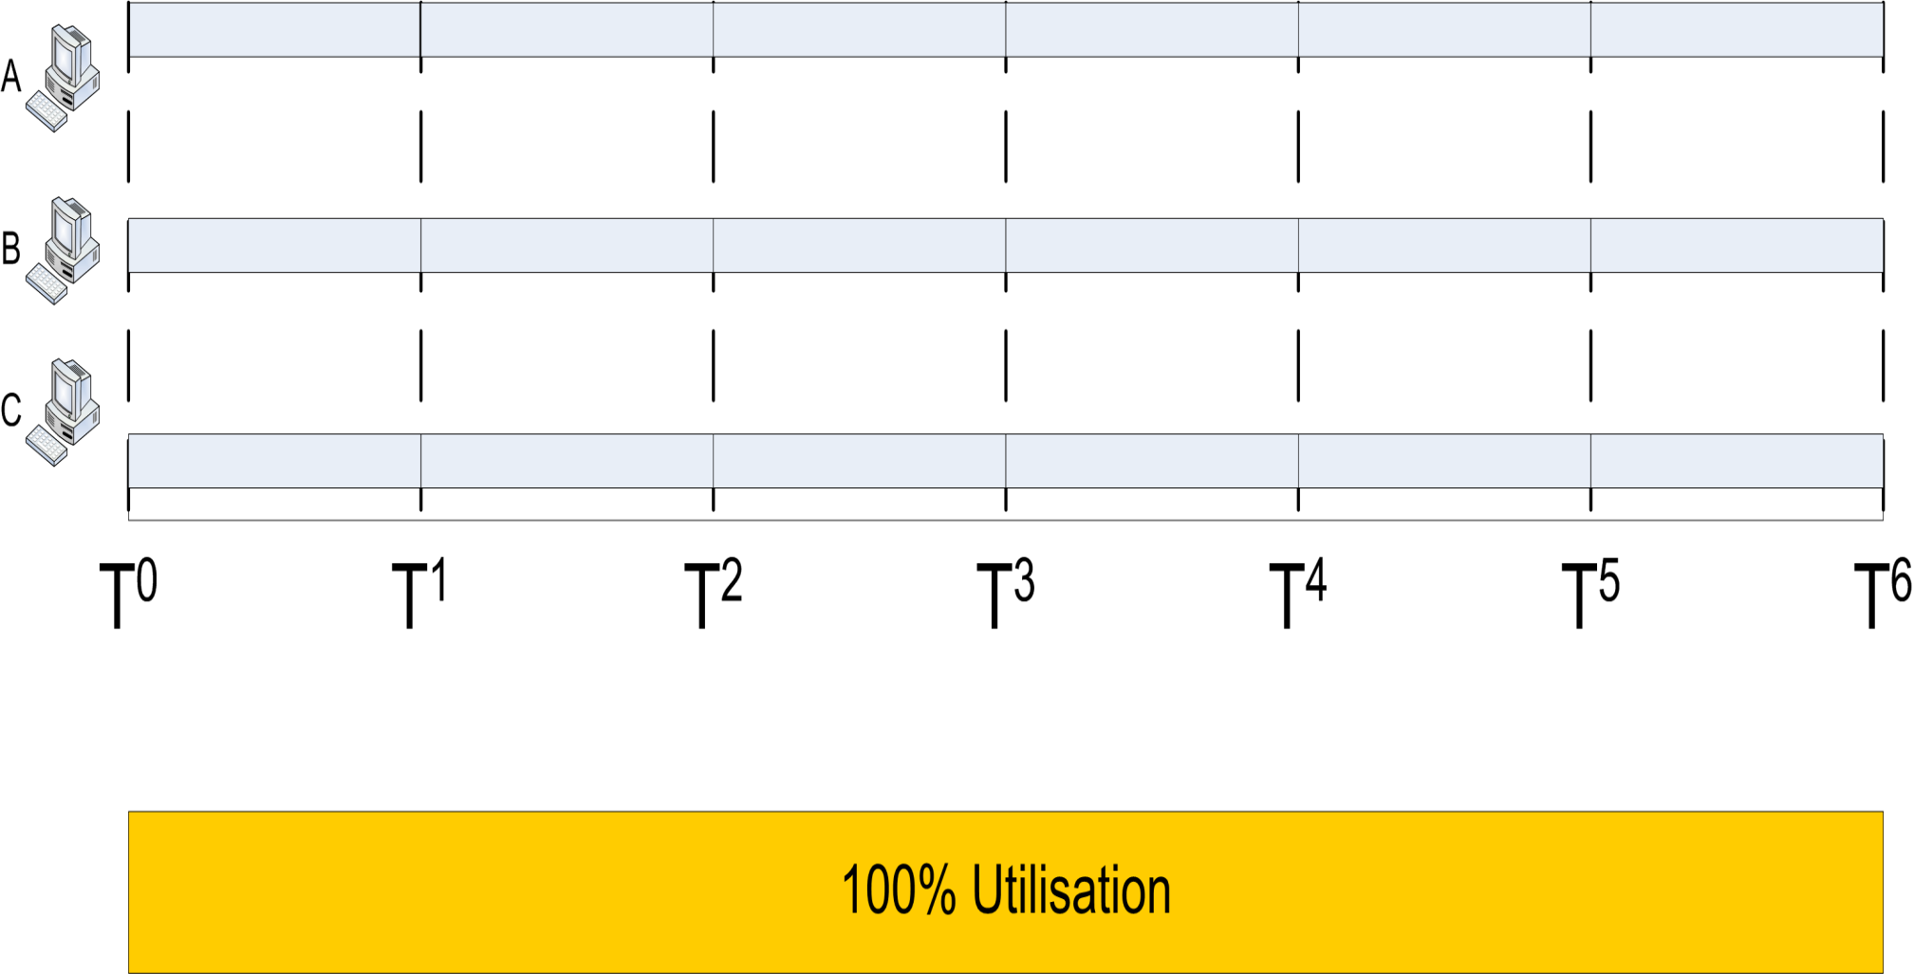
Computer Network
Static Channel Allocation

Slide 15
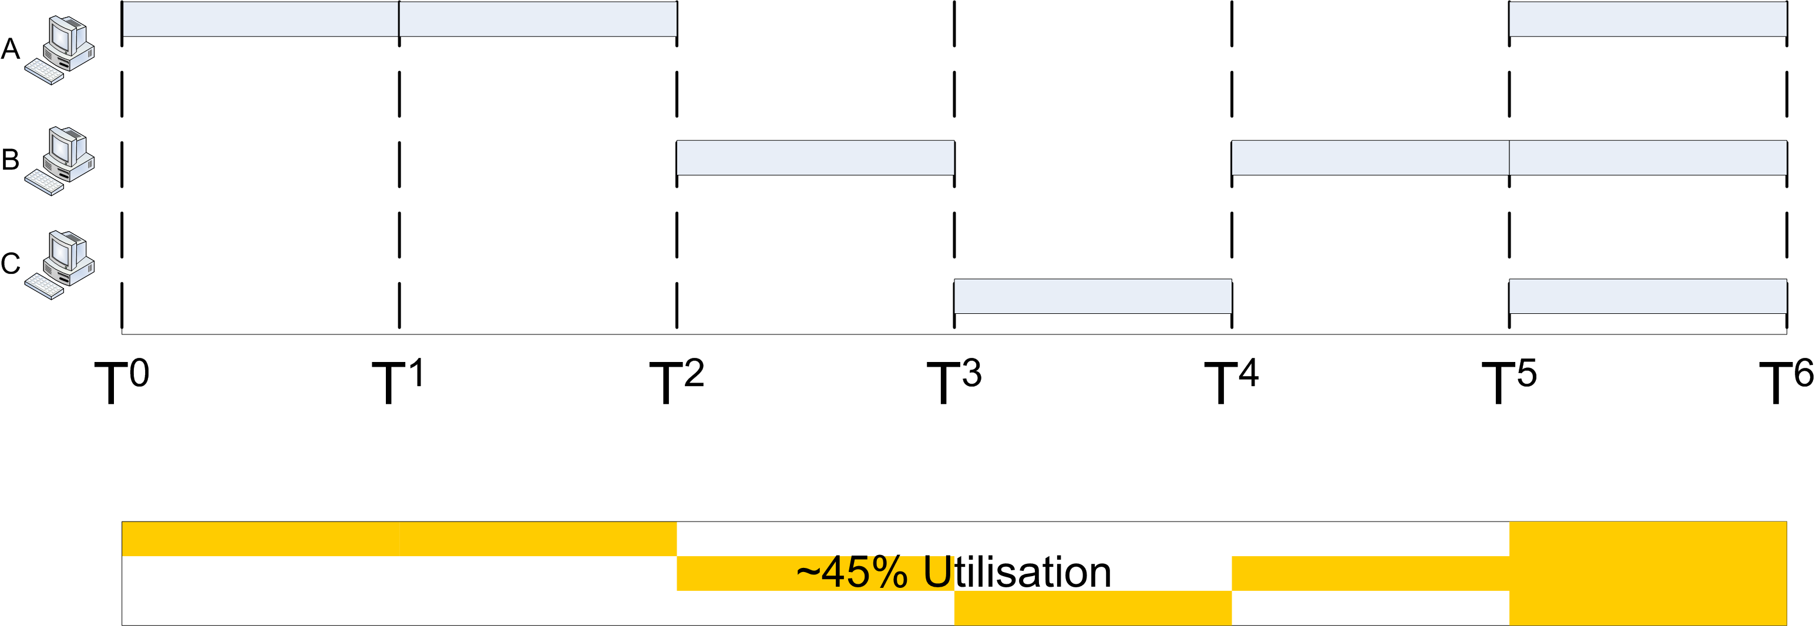
Computer Network
Static Channel Allocation

Slide 16
Computer Network
Static Channel Allocation
In Time Division Multiplexing(TDM) each station gets fixed length slot.
(length =packet transmission time) in each round.
Unused slots go idle.
example: 6-station LAN, 1,3,4 have packet.
slots 2,5,6 idle.

Slide 17
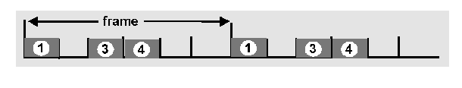
Computer Network
Static Channel Allocation

Slide 18
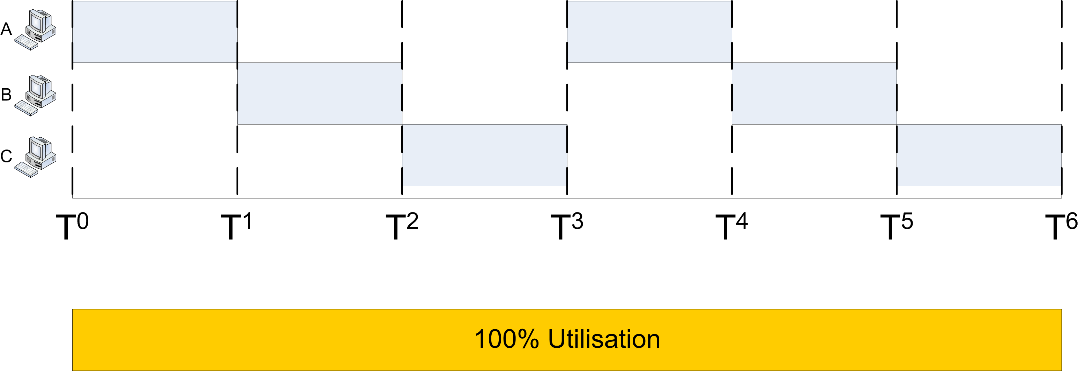
Computer Network
Static Channel Allocation

Slide 19
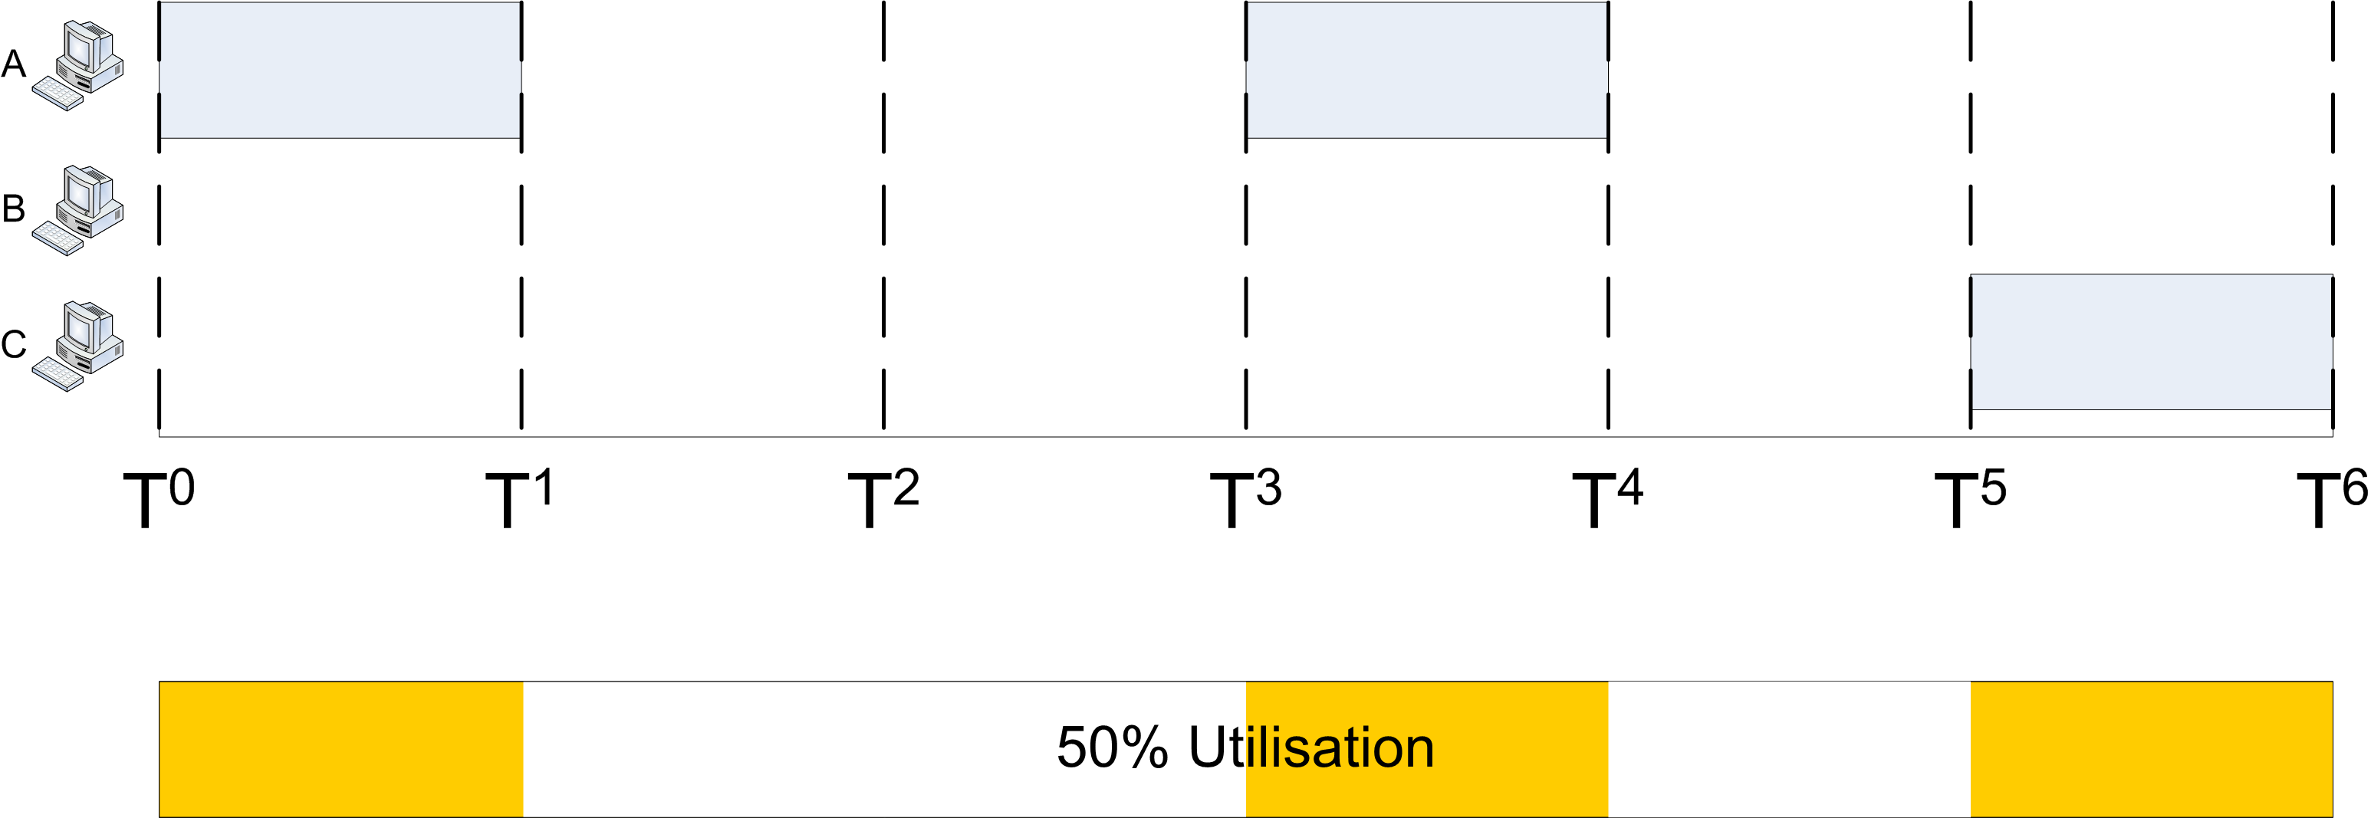
Computer Network
Static Channel Allocation

Slide 20
Computer Network
Static Channel Allocation
Both static channel allocation technique:
1. Time Division Multiplexing.
2. Frequency Division Multiplexing.
Both allocation technique works well for constant traffic and poor for bursty traffic and is idle most of the time.
Very poor in Bandwidth utilization.

Slide 21
Computer Network
Dynamic Channel Allocation
To Overcome the limitation with bursty, heterogeneous traffic we must find a dynamic way to allocate a node access to the channel.
  When a node has no traffic to send it does not waste bandwidth.
  When a node has traffic to send it can obtain all capacity of the channel, not just a slice.

Slide 22
Computer Network
Dynamic Channel Allocation
Dynamic channel allocation is based in five assumption.
Independent Traffic.
Single Channel.
Observable Collision.
Continuous or Slotted Time.
Carrier Sense or No Carrier Sense.

Slide 23
Computer Network
Dynamic Channel Allocation
Independent Traffic:-
Independent number of station generates frame for transmission.
λ= Constant,Δt= time interval.
Once frame is generated station is blocked until the frame is not successfully transmitted.
No of Frame=λΔt

Slide 24
Computer Network
Dynamic Channel Allocation
Single Channel:-
All station are provided with single shared channel.
All station can transmit and receive on the basis of priorities.

Slide 25
Computer Network
Dynamic Channel Allocation
Observable Collision:-
Collision occurs if two frames are transmitted simultaneously.
All station can detect the collision.
A mixed or collided frame has to be resend again.

Slide 26
Computer Network
Dynamic Channel Allocation
Continuous or Slotted Time:-
Frame transmission for continuous time can begin at any instant.
Slotted time or divided into discrete interval and the frame transmission must begin at the start of the slot.

Slide 27
Computer Network
Dynamic Channel Allocation
Carrier Sense or No Carrier Sense:-
With carrier sense assumption station can perceive if the channel is in use. Waits until it is free.
With no carrier sense assumption station cannot sense the channel if it is free or in use.

Slide 28
Computer Network
Multiple Access Protocols
ALOHA
System in which multiple users share a common channel.
Also known as contention protocol developed at University of Hawaii in early 1970’s by Norman Abramson and his colleague.
Abramson used short range radios(ground based radio broadcasting) to connect the users of remote island to the main computer in Honolulu.

Slide 29
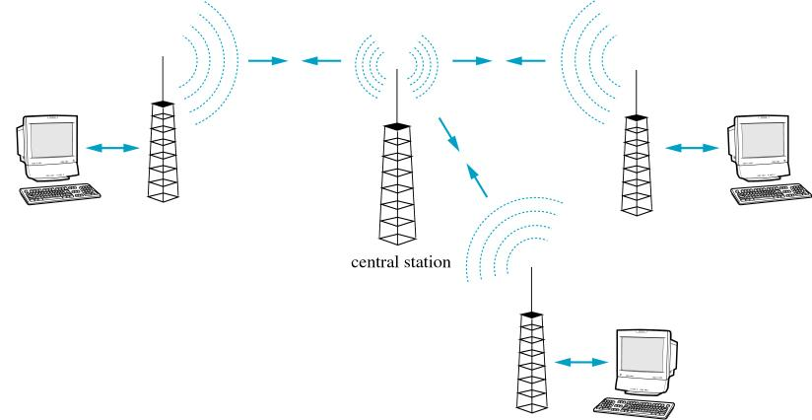
Computer Network
Multiple Access Protocols
ALOHA
The ALOHA system has two version.
Pure ALOHA and Slotted ALOHA.

Slide 30
Computer Network
Multiple Access Protocols
Pure ALOHA
Based on very simple principle.
It allows any station to broadcast anytime.
If collision occurs station waits for random time and tries again.
If the first bit of a new frame overlaps with just the last bit of a frame almost finished.

Slide 31
Computer Network
Multiple Access Protocols
Pure ALOHA
Both frames will be totally destroyed and both will have to be retransmitted later.
Sending station can listen to the broadcast to know if frame was rightly delivered.
In wired LAN the sender will be able to listen for collision while transmitting.
If all the frames are of same length the throughput of ALOHA system is maximized.

Slide 32
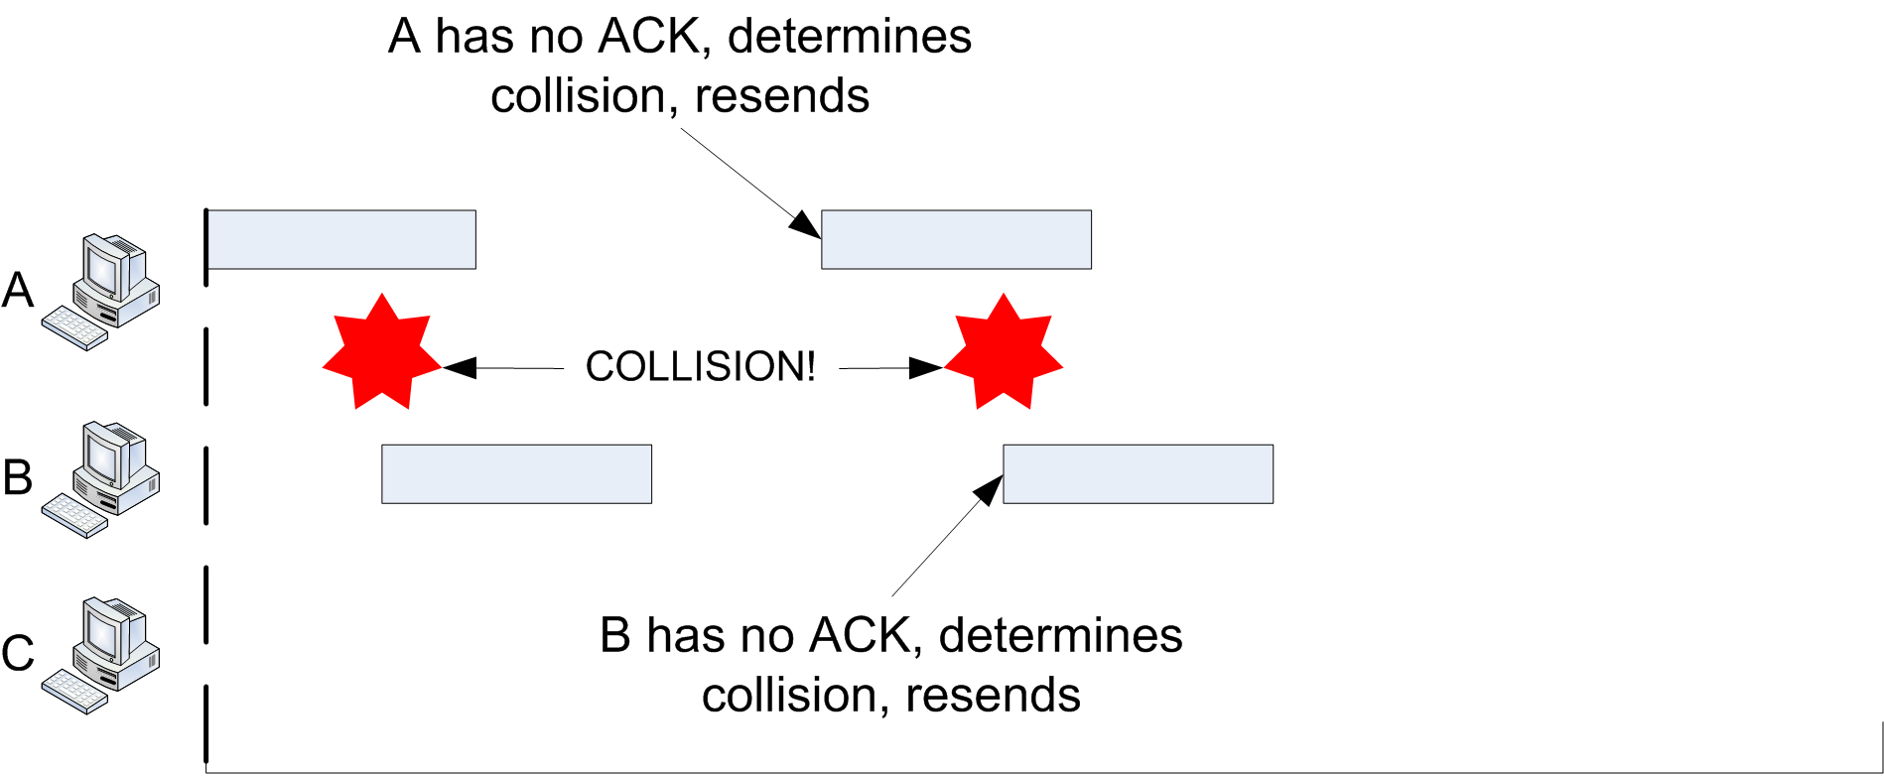
Computer Network
Multiple Access Protocols
Pure ALOHA

Slide 33
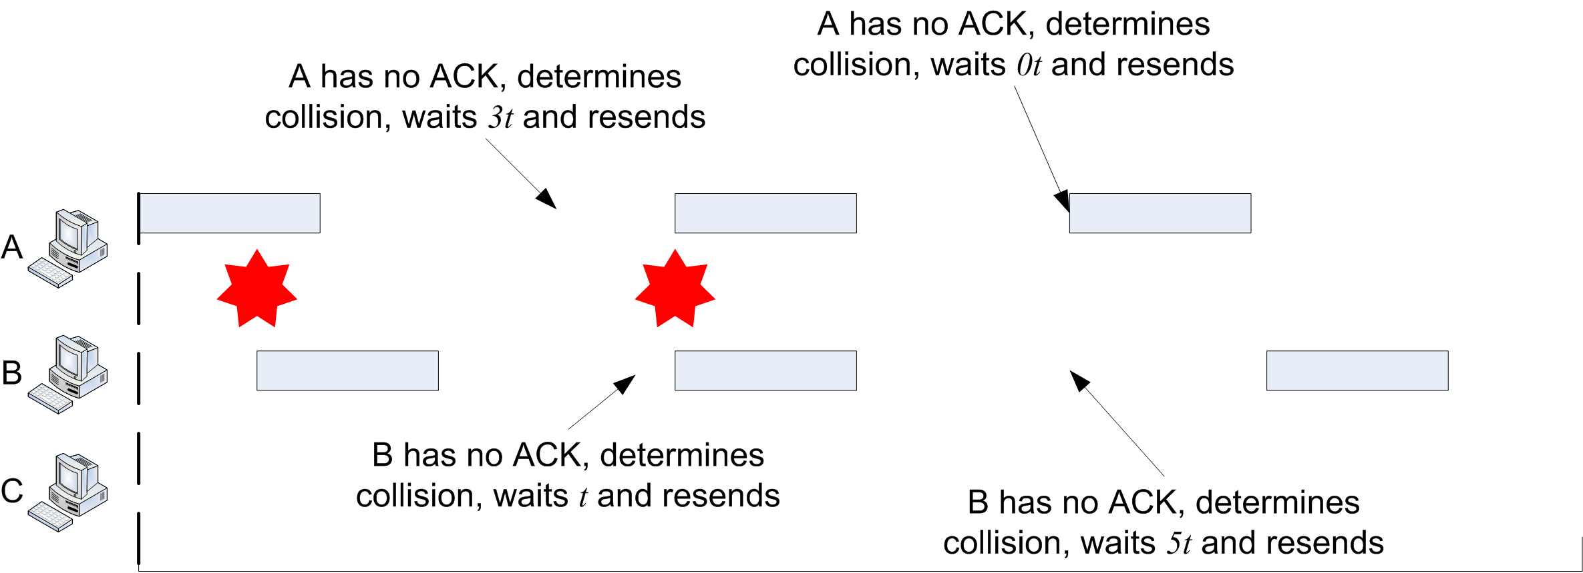
Computer Network
Multiple Access Protocols
Pure ALOHA

Slide 34
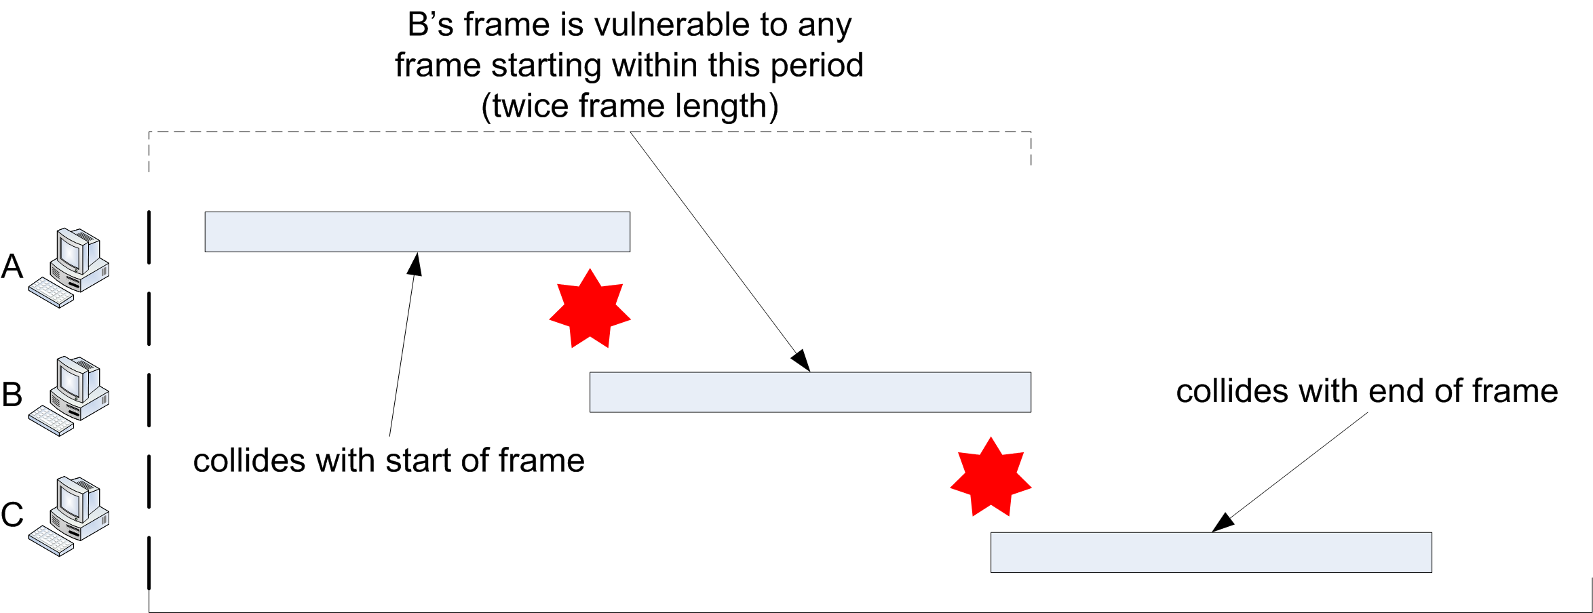
Computer Network
Multiple Access Protocols
Pure ALOHA

Slide 35
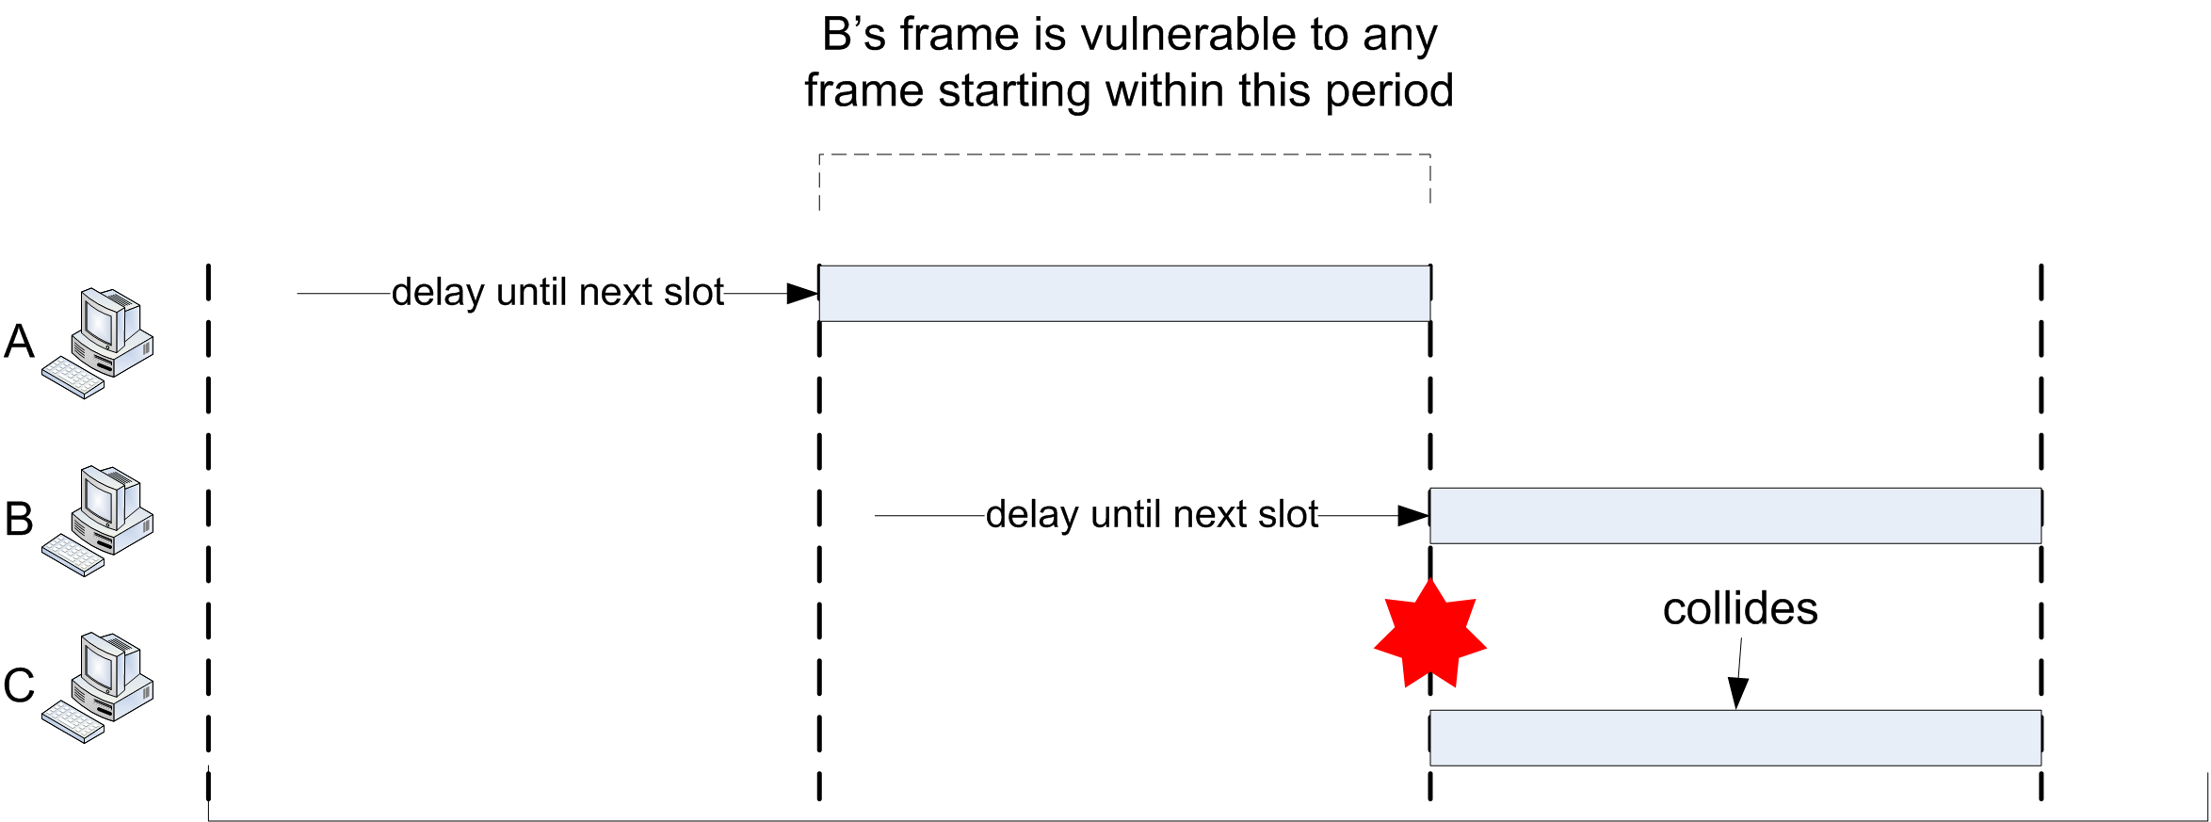
Computer Network
Multiple Access Protocols
Pure ALOHA

Slide 36
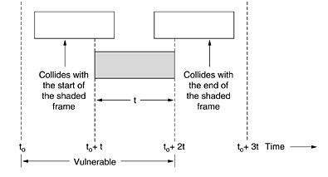
Computer Network
Multiple Access Protocols
Pure ALOHA

Slide 37
Computer Network
Multiple Access Protocols
Slotted ALOHA
Overcomes the limitations of Pure ALOHA.
Robert published method for doubling the capacity of traffic on the channel and also known as Robert Method.
Slotted ALOHA divides time into discrete interval where each interval corresponds to one frame.

Slide 38
Computer Network
Multiple Access Protocols
Slotted ALOHA
Each station transmits the data at the beginning of the slot.
Users can’t send the data as his/her wish.
Stations should wait for the beginning of the next slot to send the data which will reduce the collision.
Vulnerable period is reduce to half of that of Pure ALOHA.

Slide 39
Computer Network
Multiple Access Protocols
Pure / Slotted ALOHA
Reducing collisions increases throughput.
Throughput S = Number of frames successfully received for a given unit time. Generally:
    G = offered load (total frames generated)
    P(s) = probability of success for a single frame
    S = G × P(s)

Slide 40
Computer Network
Multiple Access Protocols
Pure / Slotted ALOHA
We can also increase S by increasing G.
But P(s) is a function of G
  For Pure ALOHA: P(s) = e^{-2G}, S = Ge^{-2G} .
  For Slotted ALOHA: P(s) = e^{-G}, S = Ge^{-G} .

Slide 41
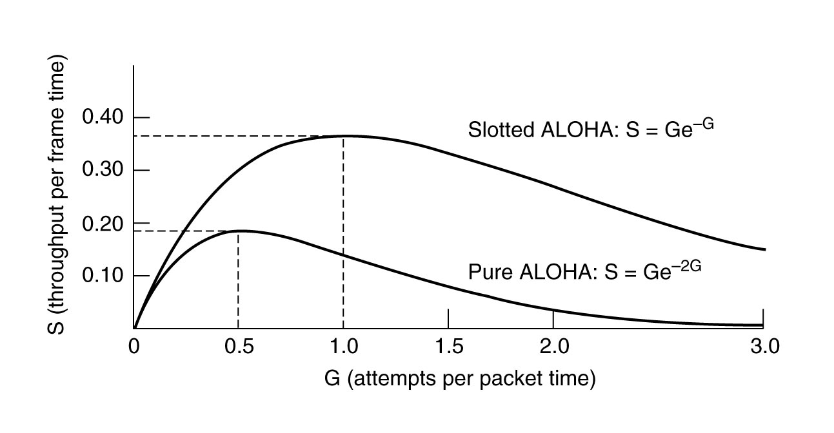
Computer Network
Multiple Access Protocols
Pure / Slotted ALOHA

Slide 42
Computer Network
Carrier Sense Multiple Access Protocols
Carrier Sense Multiple Access(CSMA) protocol operates on the principle of carrier sensing.
In this protocol Station listens the presence of carrier on the medium and is then decided to act accordingly.
It is classified as:-

Slide 43
Computer Network
Carrier Sense Multiple Access Protocols(Persistent / Nonpersistent)
1. Non-Persistent CSMA:- To transmit a frame it checks the medium. It waits if the medium is busy for fixed interval of time and checks again. If it finds free, it proceeds to transfer the frames. Algorithm leads to better channel utilization but longer delays than 1-persistent CSMA.
2. 1- Persistent CSMA:- Station monitors the medium continuously until it is idle and will transmit immediately. Collision occurs if two stations transmits at the same time.

Slide 44
Computer Network
Carrier Sense Multiple Access Protocols(Persistent/Nonpersistent)
3. P- Persistent CSMA:-
Possibility of collision and re-transmission is reduced in the P-Persistent CSMA. All station are not permitted to transmit at a time when the medium is idle.

Slide 45
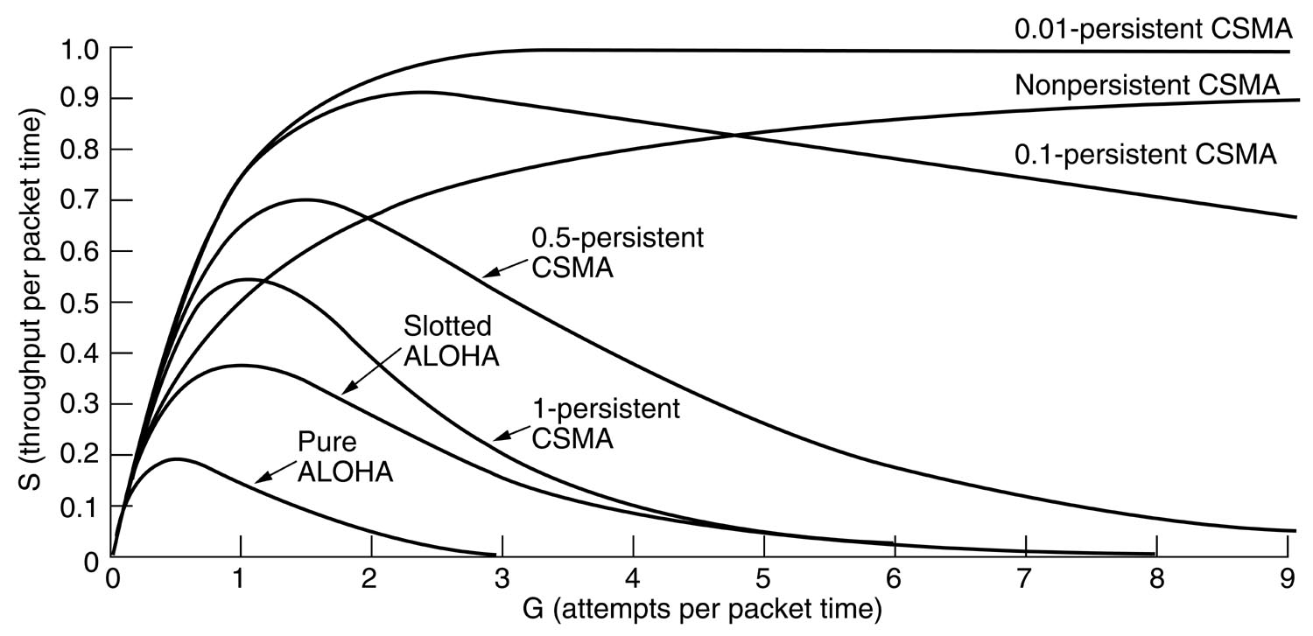
Computer Network
Carrier Sense Multiple Access Protocols(Persistent / Nonpersistent)
CSMA Performance
Fig:- CSMA Performance

Slide 46
Computer Network
Carrier Sense Multiple Access with Collision Detection(CSMA-CD)
Persistent and Non persistent CSMA protocols are clearly an improvement over ALOHA because they ensure that no station begins to transmit when it senses the busy channel.
Improvement of CSMA-CD is that the stations abort their transmissions as soon as they detect a collision.
This strategy saves time and bandwidth.

Slide 47
Computer Network
Carrier Sense Multiple Access with Collision Detection(CSMA-CD)
To reduce the impact of collisions on the network performance, Ethernet uses an algorithm called CSMA with Collision Detection (CSMA / CD.
CSMA/CD is a protocol in which the station senses the carrier or channel before transmitting frame just as in persistent and non-persistent CSMA.
If the channel is busy, the station waits.

Slide 48
Computer Network
Carrier Sense Multiple Access with Collision Detection(CSMA-CD)
It listens at the same time on communication media to ensure that there is no collision with a packet sent by another station.
In a collision, the issuer immediately cancel the sending of the package.
This allows to limit the duration of collisions: we do not waste time to send a packet complete if it detects a collision.

Slide 49
Computer Network
Carrier Sense Multiple Access with Collision Detection(CSMA-CD)
After a collision, the transmitter waits again silence, and again, he continued his hold for a random number; but this time the random number is nearly double the previous one: it is this called back-off (that is to say, the “decline”) exponential.
In fact, the window collision is simply doubled (unless it has already reached a maximum).
From a packet is transmitted successfully, the window will return to its original size.

Slide 50
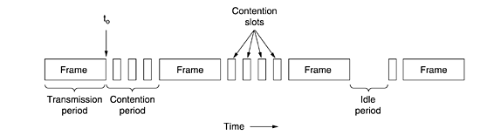
Computer Network
Carrier Sense Multiple Access with Collision Detection(CSMA-CD)
CSMA/CD is used for the traditional Ethernet.
CSMA/CD is an important protocol. IEEE 802.3 (Ethernet) is an example of CSMACD. It is an international standard.
The MAC sublayer protocol does not guarantee reliable delivery. Even in absence of collision, the receiver may not have copied the frame correctly.

Slide 51
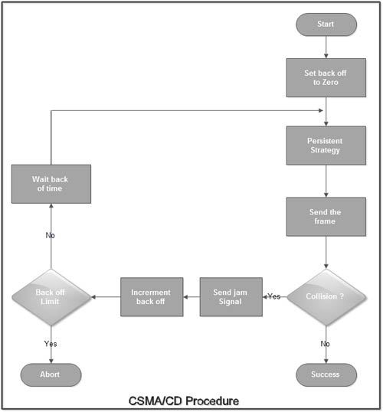
Computer Network
Carrier Sense Multiple Access with Collision Detection(CSMA-CD)

Slide 52
Computer Network
Carrier Sense Multiple Access with Collision Detection(CSMA-CD)
The station that has a ready frame sets the backoff parameter to zero.
Then it senses the line using one of the persistent strategies.
It then sends the frame. If there is no collision for a period corresponding to one complete frame, then the transmission is successful.
Otherwise the station sends the jamming signal to inform the other stations about the collision.

Slide 53
Computer Network
Carrier Sense Multiple Access with Collision Detection(CSMA-CD)
The station then increments the backoff time and waits for a random backoff time and sends the frame again.
If the backoff has reached its limit then the station aborts the transmission.

Slide 54
Computer Network
Carrier Sense Multiple Access with Collision Avoidance(CSMA-CA)
    Channel is reserved using special frames.
    Data frames will never collide.
    Used in Wireless LAN 802.11 protocol family.

Slide 55
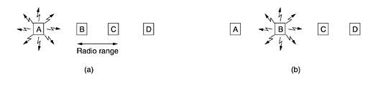
Computer Network
Carrier Sense Multiple Access with Collision Avoidance(CSMA-CA)
    Wireless LAN Protocol.

Slide 56
Computer Network
Wireless LAN Protocols
    LAN which uses radio for physical link is called a wireless LAN and is broadcast Channel.
    Wireless LAN uses CSMA but there can be interference at the receiver side.
    Problem like Hidden Terminal and exposed terminal problem may occur.

Slide 57
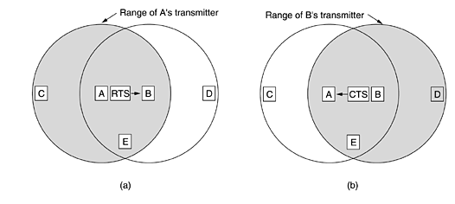
Computer Network
Wireless LAN Protocols
    Multiple Access with collision Avoidance protocol can tackle these problem.

Slide 58
Computer Network
Wireless LAN Protocols
    A starts sending Request To Send (RTS) frame to B.
    RTS frame contains the request and the length of data frame that will flow.
    B than replies with Clear To Send(CTS) frame.
    A after getting CTS frame, begins transmission of data.

Slide 59
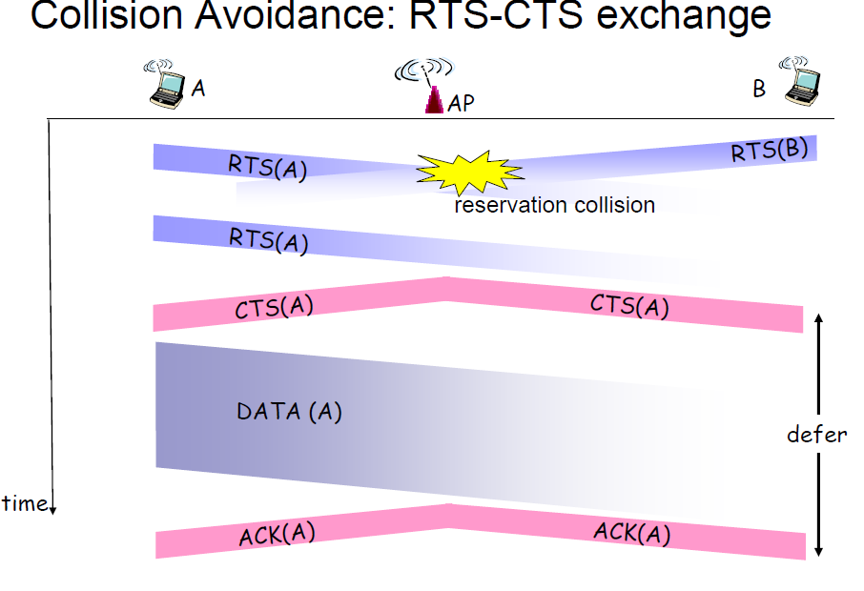
Computer Network
Wireless LAN Protocols

Slide 60
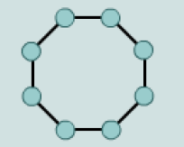
Computer Network
Token Ring
    It is also known as Token Passing and is collision free protocols.
Station
Direction

Slide 61
Computer Network
Token Passing
    Implemented protocol is called Token Bus.
    Small message so named token are send from one station to another in pre-defined manner.
    Token represents permission to send.
    Transmission of frame follows after the token and reaches to pre-defined destination.

Slide 62
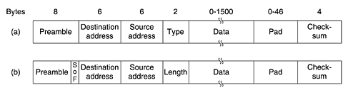
Computer Network
Ethernet
    Ethernet is also named as MAC Sublayer Protocol.
Fig:-Frame formats. (a) DIX Ethernet. (b) IEEE 802.3.

Slide 63
Computer Network
Ethernet
    Ethernet are also classified as Classic Ethernet and Switched Ethernet.
    Classic Ethernet provides with the speed of 3 to 10 Mbps.
    Switched Ethernet runs at 100,1000,10000 Mbps named with Fast Ethernet, Gigabit Ethernet and 10 Gigabit Ethernet.
    Only switched Ethernet is used nowadays.

Slide 64
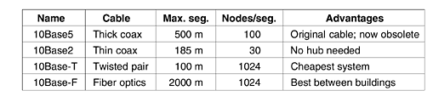
Computer Network
Ethernet

Slide 65
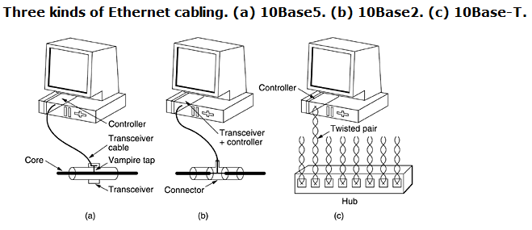
Computer Network
Ethernet

Slide 66
End of Lecture 6
THANK YOU !!!

